Slide 1


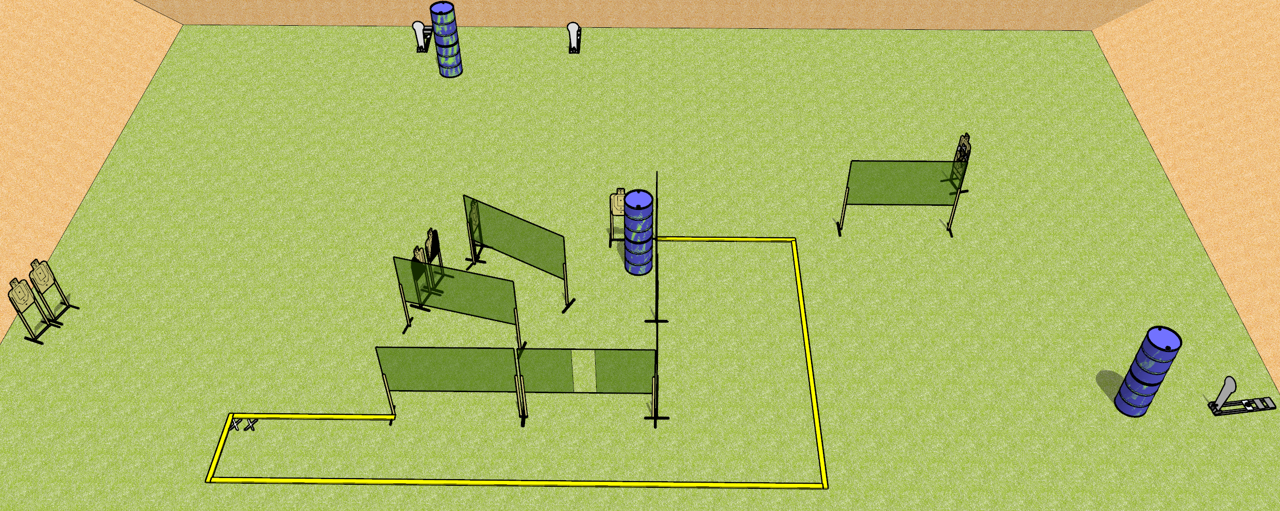
 | Dothan Gun Club – USPSA Match The 8-3-3 Course Designer : Drew Coleman
Round Count 27 rounds 8 USPSA Targets 3 Colt poppers
Equipment List 1 medium fault line 11 wall feet

Slide 2
The 8-3-3
Written Stage Briefing
The 8-3-3 is a 27 round, 135 point, Comstock course of fire. There are 8 USPSA targets and 3 colt poppers. The best 3 hits on paper will score, and steel must fall to score. The start signal is audible.
Handgun start position is both feet on X’s, wrists below belt. Handgun is loaded and holstered.
PCC start position is both feet on X’s. Loaded carbine is held with both hands, stock on belt, safety on.
On start signal, engage targets as they become available from within the shooting area.

